Slide 1


Introduction to Web-based Analyses for Bacterial Typing
Gildas Hounmanou, PhD
APTI-Fellow, National Institutes of Health, MD, USA
Assistant-Professor
https://orcid.org/0000-0003-3991-0864
University of Copenhagen
Faculty of Health and Medical Sciences
Section for Food Safety and Zoonoses
Department of Veterinary and Animal Sciences

Slide 2
General concepts
Species identification
Bacterial subtyping (MLST, serotyping)
Practical
Outline

Slide 3
General concepts

Slide 4
Sequence Alignment (Applications)
Discover functional information (annotation)
Predict molecular structure
Predict shared ancestry
Phylogenetic analysis
Sequence typing and identification (speciation, MLST prediction etc)
Subject Query
Alignment
Best match (query sequence function predicted)
Query sequence (unknown function)
Database sequences (known function)

Slide 5
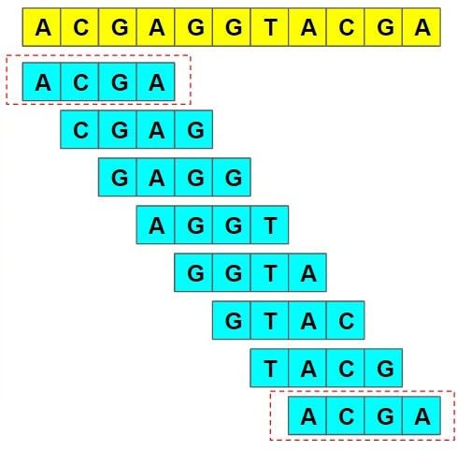
Kmers
Contiguous substrings of a given sequence, each having length k (positive integer)
Similar sequences expected to share more kmers in common
4-mers

Slide 6
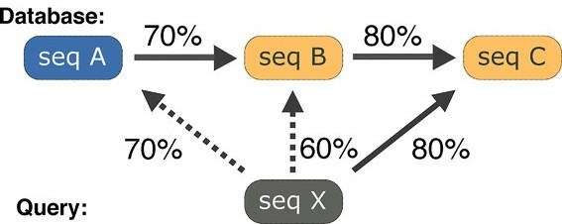
Databases
Publicly accessible repository of [annotated] sequences
Any prediction tool is only as good as its queried database
Curated vs non-curated databases
Find best matches for a query sequence in the database of sequences

Slide 7
Species identification

Slide 8
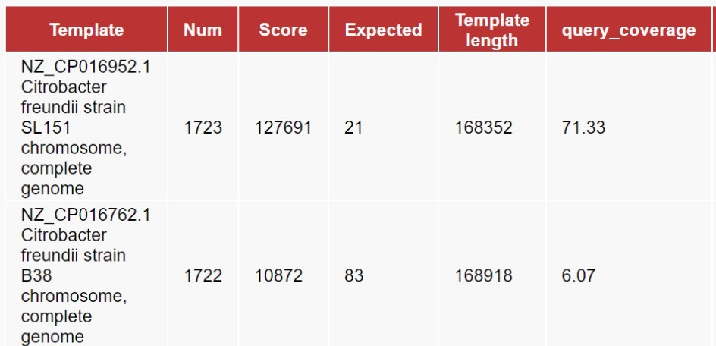
KmerFinder Tool
https://cge.food.dtu.dk/services/KmerFinder/
Query sequence
1
Create kmers of length n
2
3
Count matching kmers and report best matching species
Species 1
Align kmers to the kmers of each species in the database
Species 2
Species 3
KmerFinder database
10

Slide 9
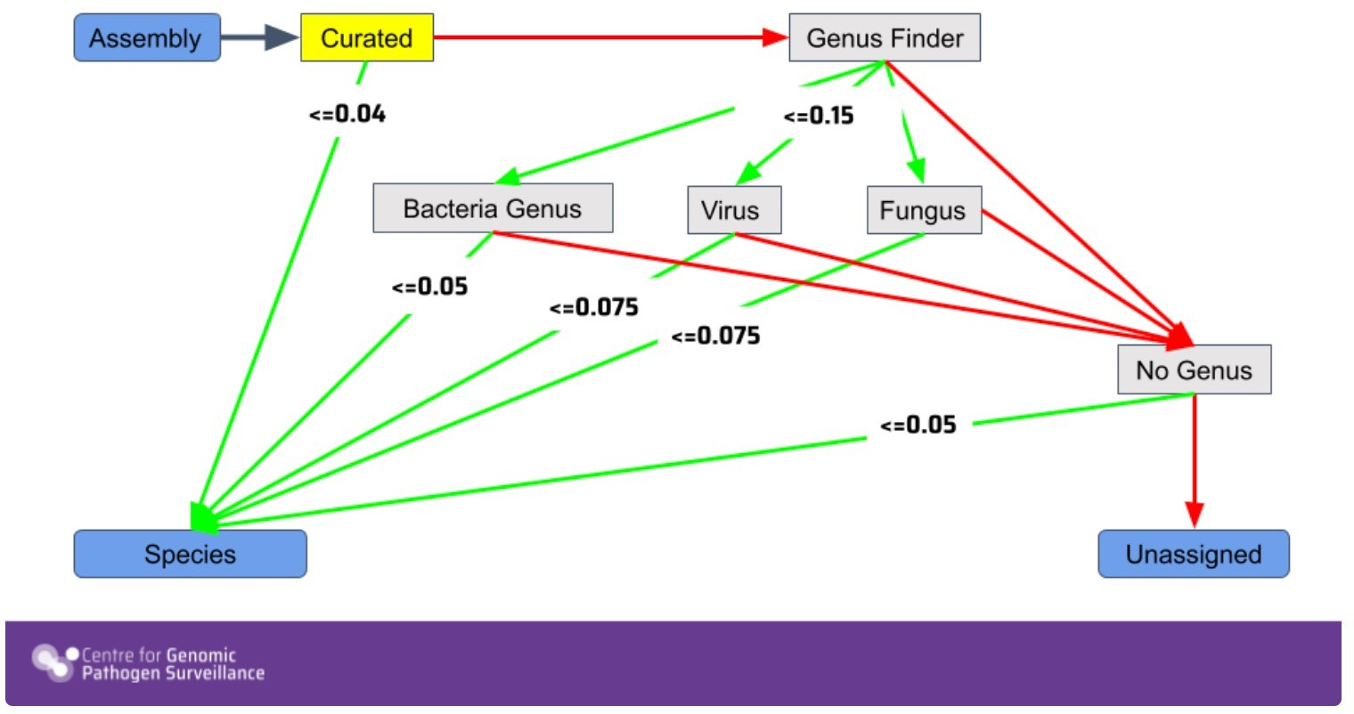
Pathogenwatch (Speciator)
https://pathogen.watch
11

Slide 10
Bacterial subtyping

Slide 11
Why subtype?
Sub-classification of separate bacterial strains within the same species
Delineate virulent subtypes (e.g., E. coli O157:H7)
Epidemiological surveillance
Outbreak investigation
Identify emerging pathogenic strains (e.g., hybrid pathotypes)

Slide 12
Sequence-based subtyping
Merits:
Not all genetic changes translate to morphological change
Morphological convergence
More “characters” compared
Increased WGS access
SNPs
Discriminatory power
wgMLST
cgMLST
Serotyping
MLST
16S-based speciation
SNPs – single nucleotide polymorphisms; wg – whole genome; cg – core genome

Slide 13
Multi-locus sequence typing (MLST)
Whole genome- or PCR-based sequencing of selected (n) housekeeping genes
Genetic changes in these genes are constrained but discriminatory
Multiple loci (usually 7) studied to address lack of congruence in bacteria
Typically compares sequences of gene fragments (300 – 550 bp)
Allele numbers for each loci assigned in order of discovery
All allele numbers form an allelic profile
Each ST corresponds to a unique allelic profile; STs are also assigned in order of discovery; database updated with new alleles and STs
Clonal complexes typically defined as clusters with 1 or 2 varying loci

Slide 14
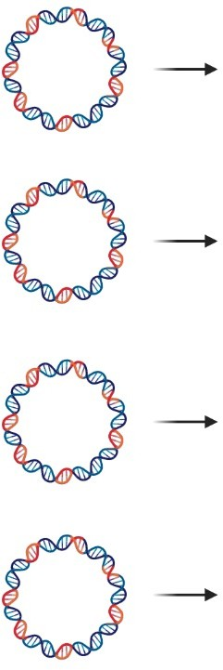
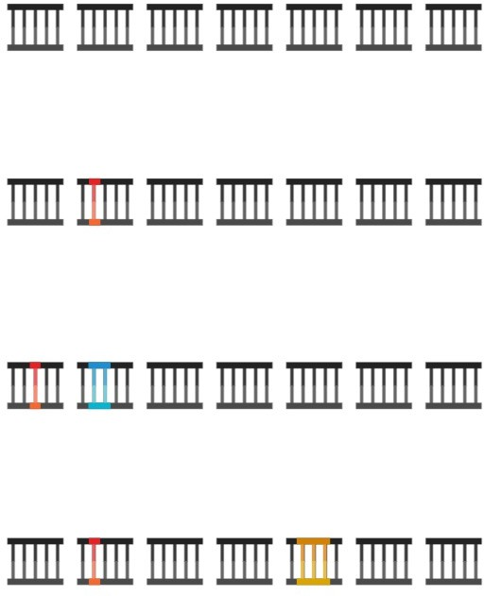

Genes/loci
Allele profile
Sequence type
Clonal complex
1 1 1 1 1 1 1
ST 1
CC 1
-
1
1
1 1 1
1 1
Isolate 1
1 2 1 1 1 1 1
ST 2
CC 1
1 2
1 1 1
1 1
Isolate 2
2 3 2 2 1 2 2
ST 3
-
2 3
2 2 1
2 2
Isolate 3
1 2 1 1 2 1 1
ST 4
CC 1
1
2
1 1 2
1 1
Isolate 4

Slide 15



MLST: Pros and cons
Portable databases; reproducible between PCR and genomic sequencing labs
Poor resolution for outbreak investigations
* Arbitrary allele/ST numbering does not reflect
relationships and eliminates need for
nomenclature revisions
Artefactual STs, e.g., due to gene duplications
Low cost and scaleable
Allele numbering lacks *
phylogenetic meaning
Good resolution for epidemiological
surveillance
Gene fragments not optimal for population studies
Falling sequencing costs -> increased access & expanded
species spectra
No universally applicable MLST schemes

Slide 16
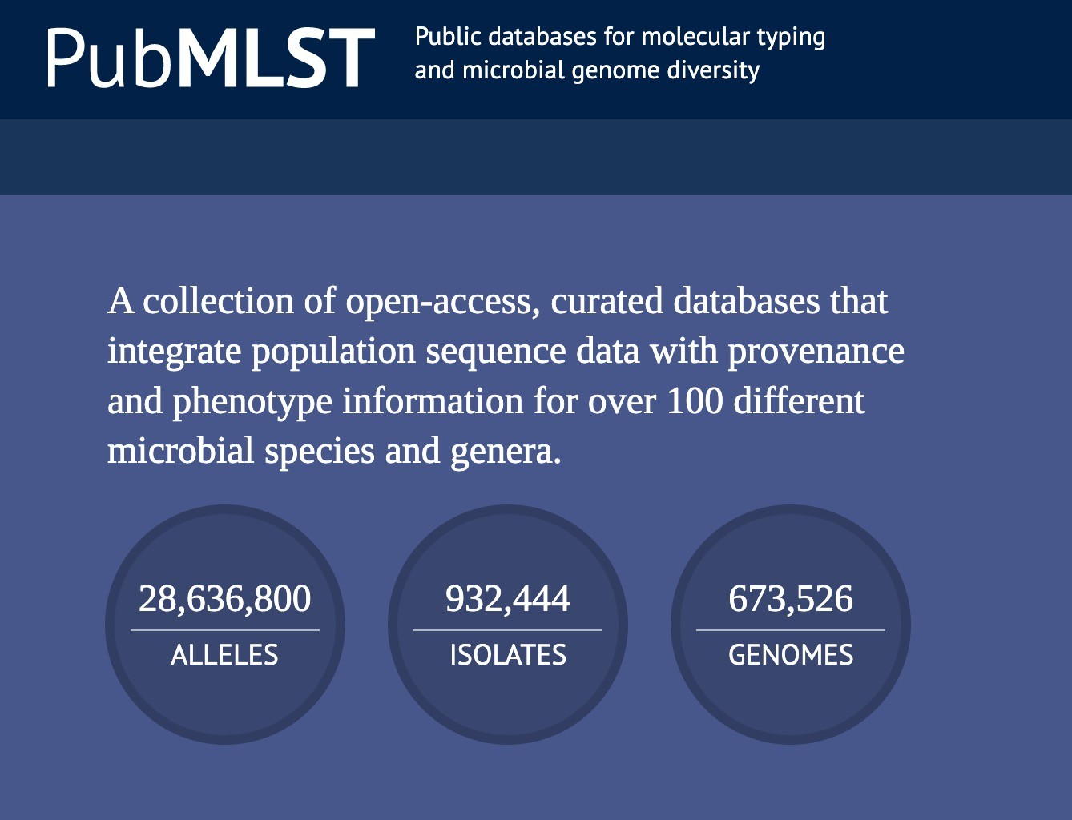
pubmlst.org

Slide 17
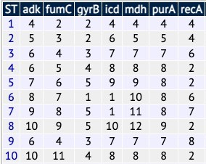
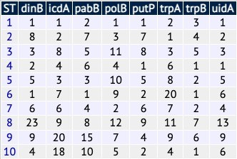
Escherichia coli MLST schemes (pubmlst.org)
Achtman scheme
Pasteur scheme
https://pubmlst.org/bigsdb?db=pubmlst_escherichia_seqdef https://enterobase.readthedocs.io/en/latest/mlst/mlst-legacy-info-ecoli.html

Slide 18
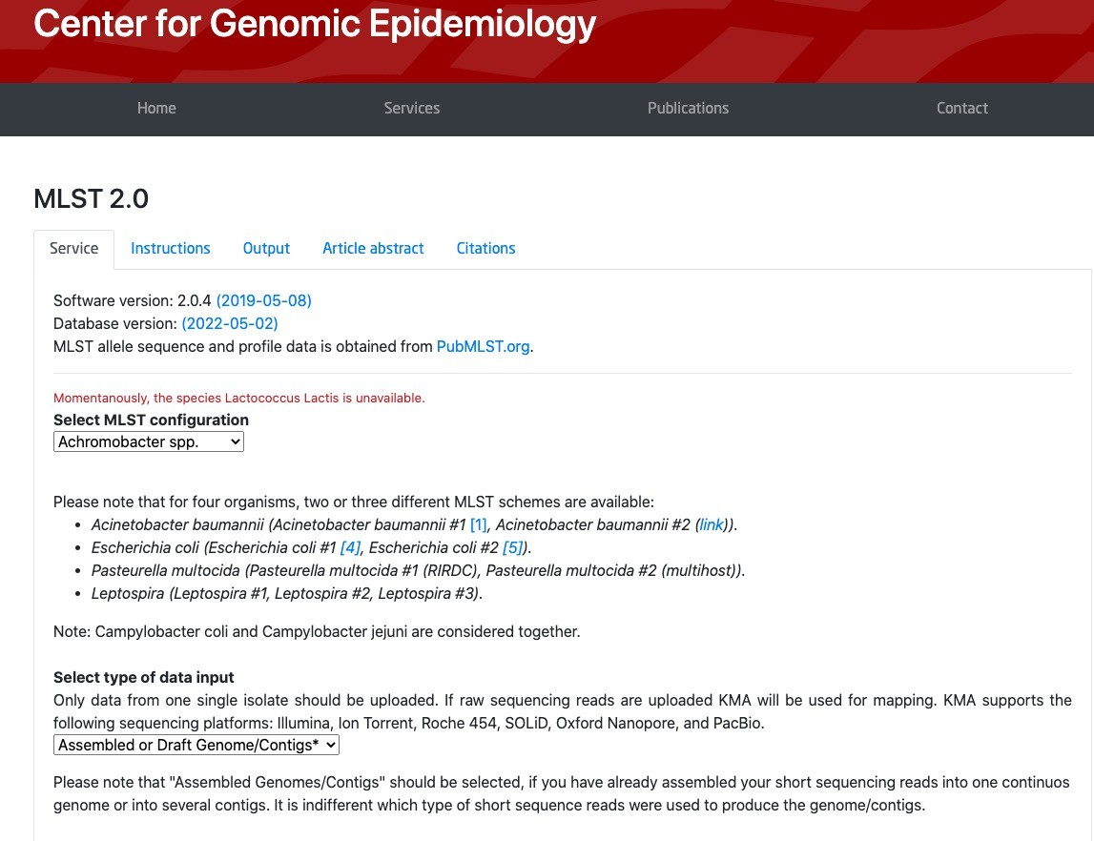
MLST 2.0 (CGE)
Platform: Web-based
Input:
Sequence reads (.fastq) OR assemblies (.fasta)
URL:
https://cge.food.dtu. dk/services/MLST/
Available for many clinically important species; regularly updated DB
Comments:

Slide 19
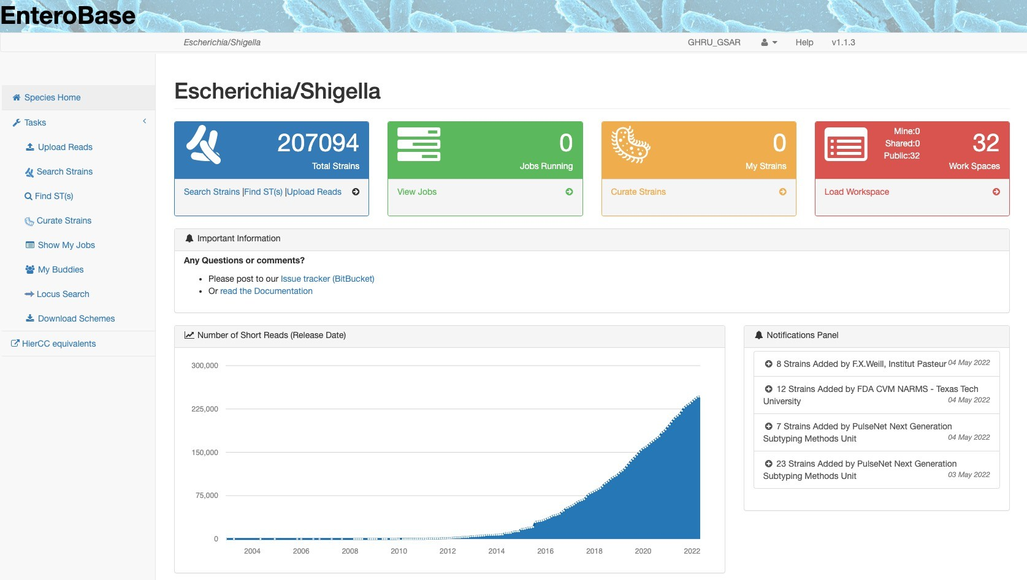
Enterobase
Platform: Web-based
Input:
Sequence reads (fastq)
URL:
https://enterobase. warwick.ac.uk/
Specific for E. coli, Salmonella, etc.
Also generates cgMLST, serotyping results, etc.
Comments:

Slide 20
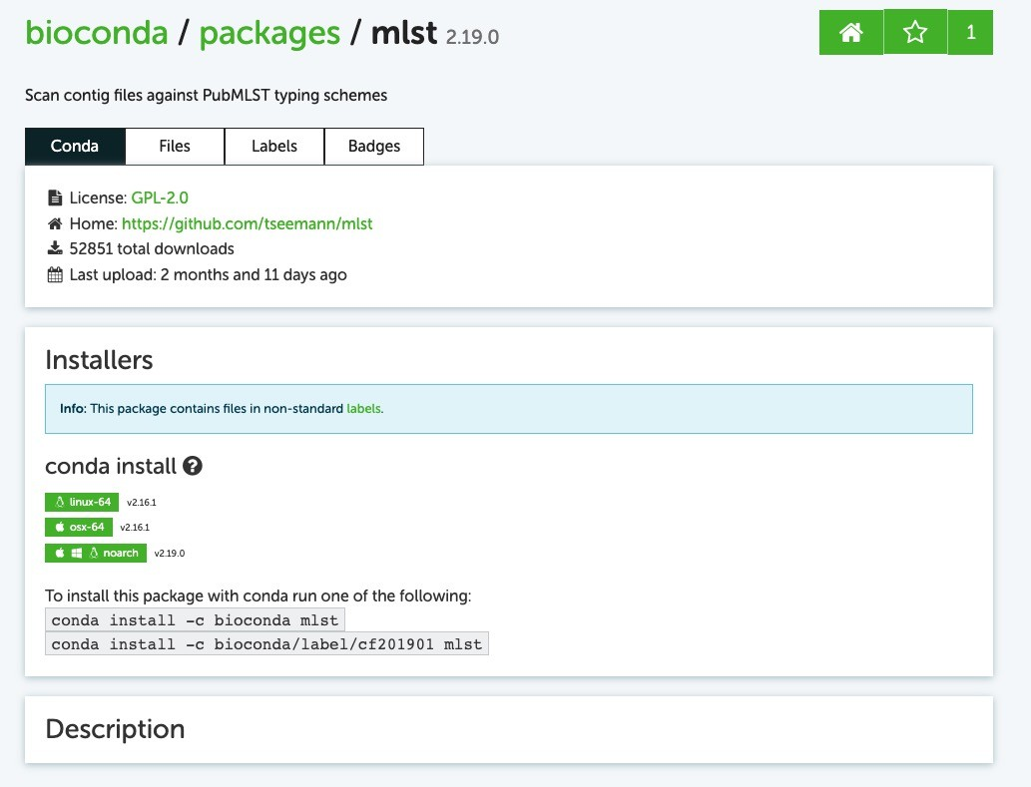
MLST
Platform:
CLI (Linux/OS X)
Input:
Assembled and/or annotated genomes (fasta/GenBank/EMBL)
https://github.com/ts eemann/mlst
Preferred for large datasets; manually update database once installed
URL:
Comments:

Slide 21
E. coli serotyping
Serological typing based on differences in the lipopolysaccharide O antigen, capsular K antigen, and flagellar H antigen.
Serotype information very useful epidemiologically because it is directly linked to antigenic response
Poor phylogenetic correlation due to high propensity for recombination in these genes
WGS serotyping based on sequence similarity
O:H typing (standard serotyping) from WGS data:
O group:
O-antigen processing genes: wzx, wzy, wzm, and wzt
H group:
Flagellin-encoding genes – fliC, flkA, fllA, flmA and flnA

Slide 22
Salmonella serotyping
Phenotypic serotyping
Labor-intensive and expensive
Requires procurement and storage of multiple antisera
Serovars designated by names or antigenic formula in the format: O:H1:H2
Over 2500 serotypes in White-Kauffmann-Le Minor scheme
Specific combinations of O and H antigenic types represent serotypes/serovars
Genome-based serotyping targets same antigens as phenotypic assays:
Somatic (O) group antigen – rfb gene cluster (wzx, wzy, others)
Flagellar antigens – fliC and fljB
Zhang et al (2015) https://doi.org/10.1128/JCM.00323-15

Slide 23
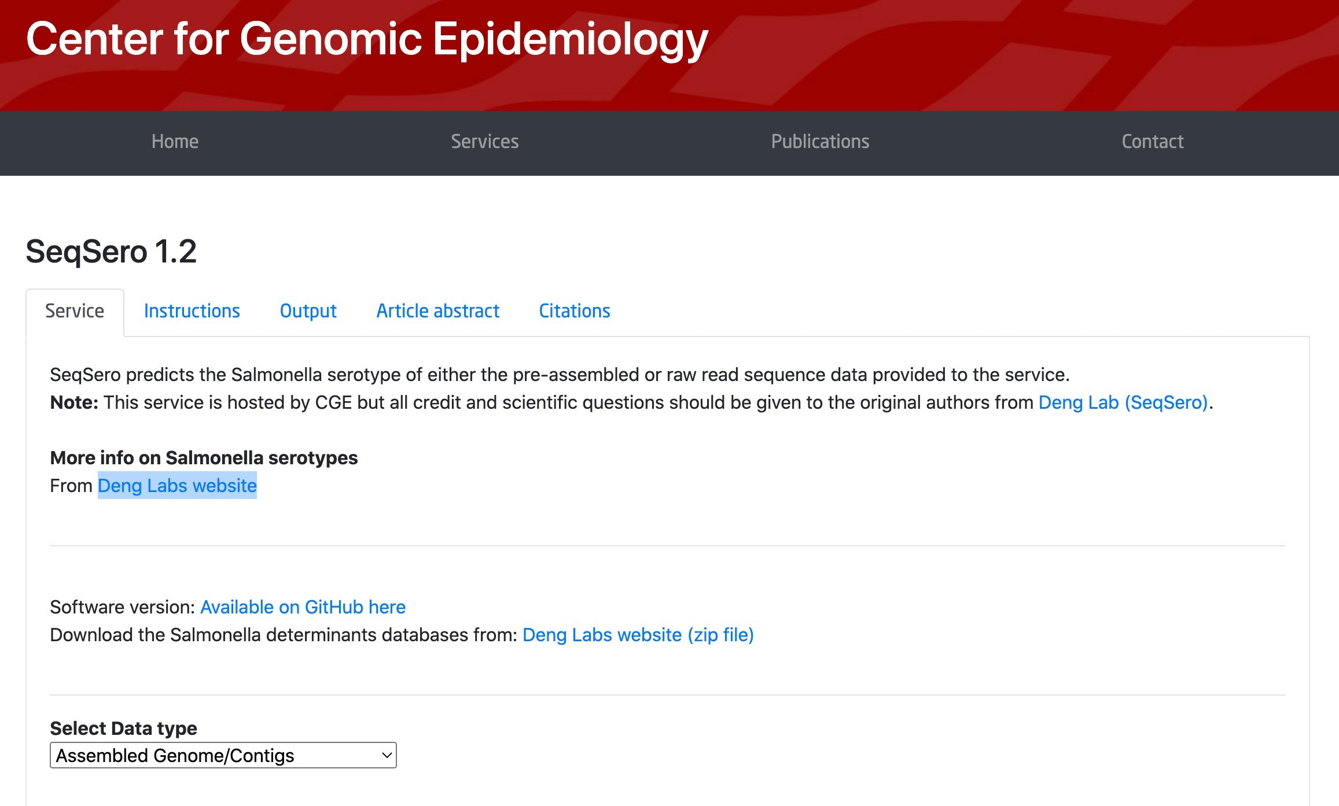
SeqSero (CGE)
Platform: Web-based
Input:
Sequence reads (.fastq) OR assemblies (.fasta)
URL:
https://cge.food.dtu.dk/s ervices/SeqSero/
Salmonella serotyping
Comments:

Slide 24
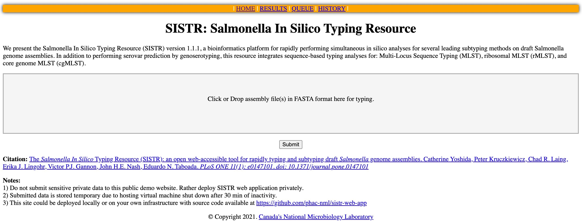
SISTR
Platform:
Web and CLI (Linux / OS X)
Assemblies (fasta)
Input:
URL:
https://github.com/ph ac-nml/sistr_cmd https://sistr- app.herokuapp.com/
Salmonella typing: serovar and serogroup prediction, cgMLST, etc.
Comments:

Slide 25
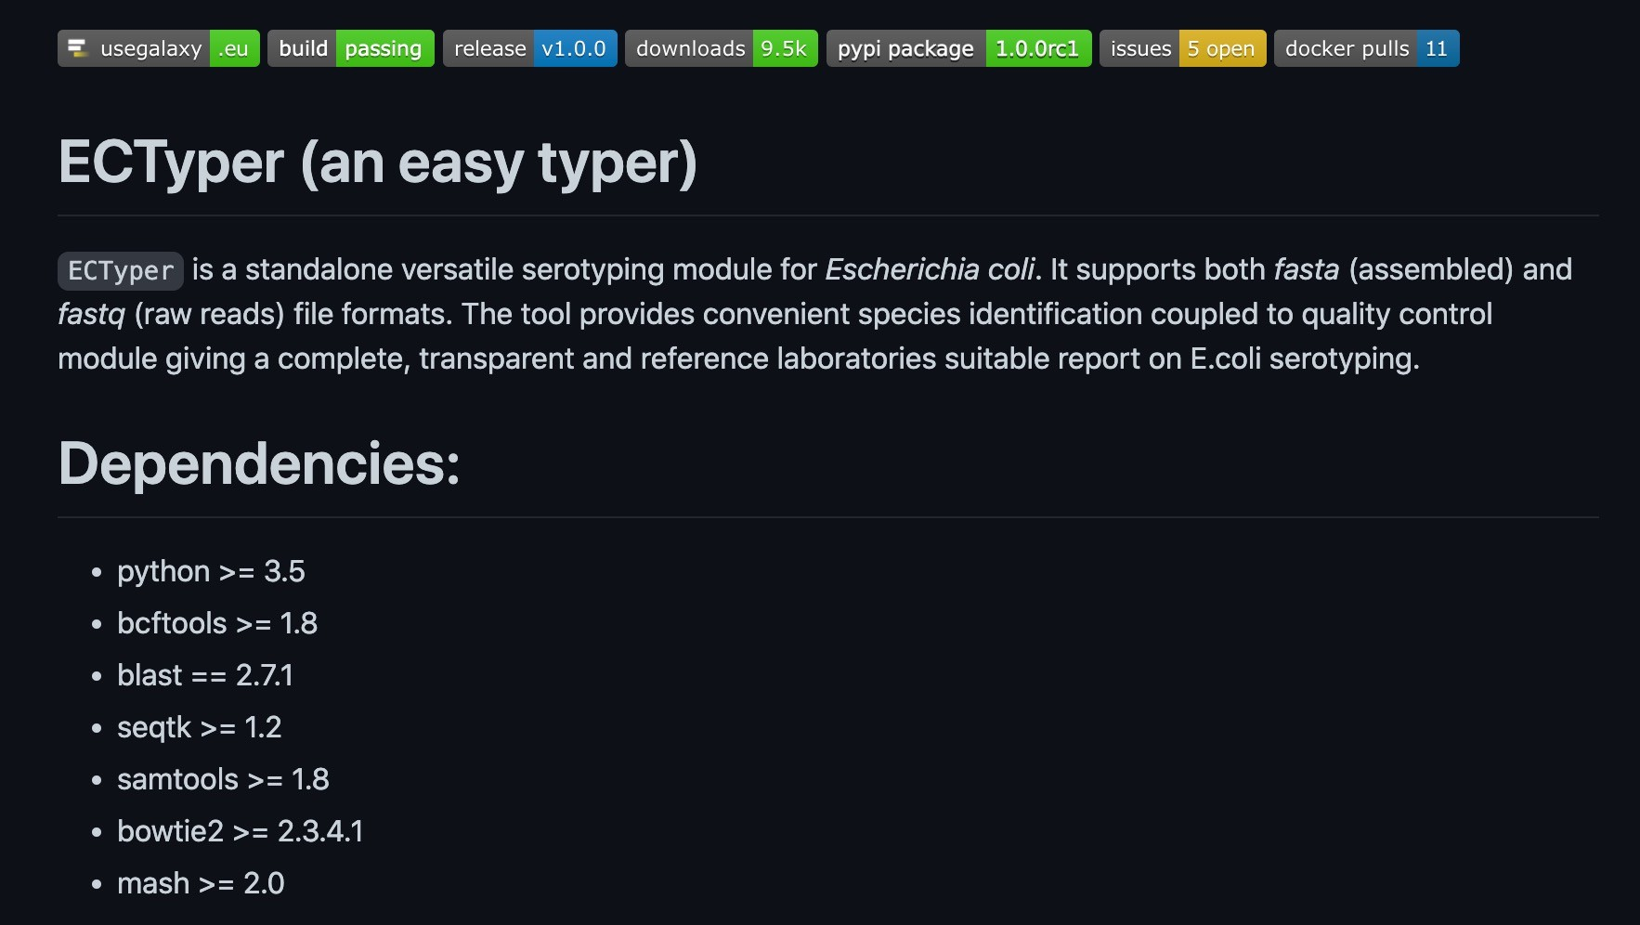
ECTyper
Platform: Web and CLI
Input:
Assemblies (fasta) or raw reads (fastq)
https://github.com/phac- nml/ecoli_serotyping
URL:
https://usegalaxy.eu/root
?tool_id=ectyper
E. coli serotyping
Comments:

Slide 26
Practical

Slide 27
Use the genomes provided for the following interactive tasks
CGE tools: https://cge.food.dtu.dk/services/
Species identification
MLST determination
Serotyping (if applicable)
Multi-analyses tools:
Pathogenwatch [and Kleborate] - https://pathogen.watch/
Enterobase - https://enterobase.warwick.ac.uk/

Slide 28


Gildas Hounmanou, PhD
APTI-Fellow, National Institutes of Health, MD, USA
Assistant-Professor
https://orcid.org/0000-0003-3991-0864
University of Copenhagen
Faculty of Health and Medical Sciences
Section for Food Safety and Zoonoses
Department of Veterinary and Animal Sciences

